Slide 1
Economic Geography
What Influences Economic Activity?
Sectors of the Economy
Location Factors in Services

Slide 2
Economic geography
How do people earn a living?
Physical environment
Cultural conditions
Technology
Politics/economic system
How does that vary by place?
How does it connect places?
Notes:
2 – based on physical, environmental, historical
3 – places cannot produce everything so they need to trade

Slide 3
What influences economic activity?
A country’s access to human, natural and capital resources.
Do they have a skilled workforce? Do they have natural resources? Are their transportation and communication networks modern, outdated or nonexistent? Do they have access to new technology?

Slide 4
What influences economic activity? cont.
A country’s location and ability to exchange goods.
Are they landlocked? Are they an island or coastal nation? How close are they to shipping lanes? What is their access to communications

Slide 5
What influences economic activity? cont.
They are members of a political or economic alliance that provides access to markets.
Examples would be, the European Union (EU), North American Free Trade Agreement(NAFTA)

Slide 6
Why do countries trade?
Think about the concepts of spatial interaction:
Complementarity - when two regions, through trade, can specifically satisfy each other's demands
Transferability – refers to the costs involved in moving goods from one place to another. When costs of moving people are goods from one place to another are high, transferability decreases, but when costs are low, transferability increases.
Intervening Opportunity – a closer opportunity, greatly diminishes the attractiveness of sites farther away.
To import goods and services they need
To export goods and services they can sell for profit
Notes:
Florida has a high degree of complemtarity with the northeastern US, because it supplies fresh fruits and veggies to the NE that only can be grown in Florida’s warm subtropical climate. Florida provides the supply, the NE provides the demand.
IO – If West Virginia which is closer in absolute distance to the large cities of the eastern seaboard than Florida, had a warm subtropical climate appropriate for growing citrus fruits, then it would make sense to ship those products from West Virginia.

Slide 7
What is comparative advantage?
Comparative advantage means a country will export goods and services that they can produce at lower relative costs than other countries.

Slide 8
What are the effects of comparative advantage?
Enables nations to produce goods and services they can sell for profit
Influences the development of industries (ex. steel, aircraft, automobile, clothing)
Supports specialization and efficient use of human resources
A driver of trade between countries

Slide 9
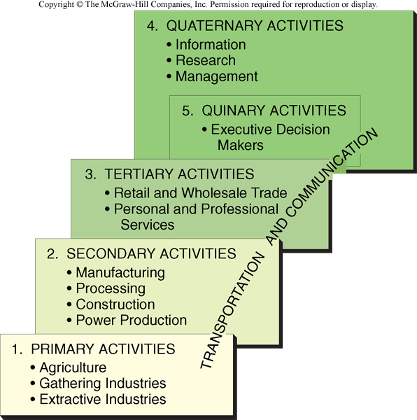
Five Sectors of the Economy

Slide 10
Primary economic activity
“Gathering” industries
Fishing
Forestry
Commercial vs. subsistence
Potentially renewable resources
“Extractive” industries
Mining
Quarrying (gravel, sand)
Nonrenewable resources
Huge capital investment: then what?

Slide 11
Economic Activity in Primary Sector
What are the spatial patterns that emerge from this map and the next map? Does the percentage of activity derived from primary economic activity correlate with economic development/prosperity? Does having certain resources allow for greater prosperity?

Slide 12
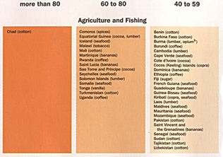
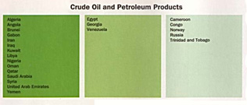
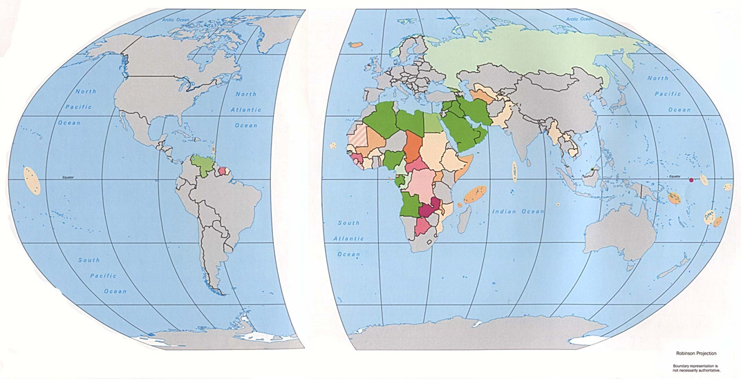

Slide 13
Shift in agriculture employment
Why do you think we see a decline in agricultural employment? Think back to the ag unit and the changes discussed there.

Slide 14
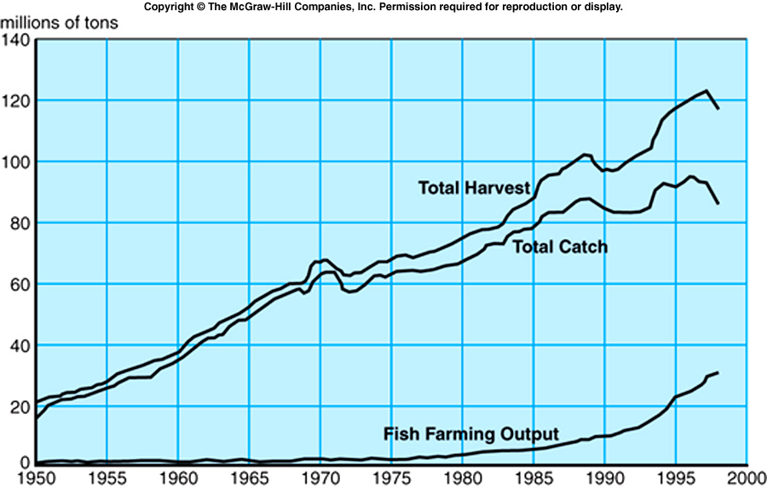
Fisheries
Protein for 1 billion people
Inland 6%, aquaculture 23%, oceans 71%
Tragedy of the commons

Slide 15
Forestry
Commercial use or fuelwood
Coniferous (softwood) for paper, lumber
Deciduous (hardwood) for furniture, etc.
Tropical hardwood for fuelwood, furniture
And clearing land for other economic activities (agriculture, mining, urbanization)

Slide 16
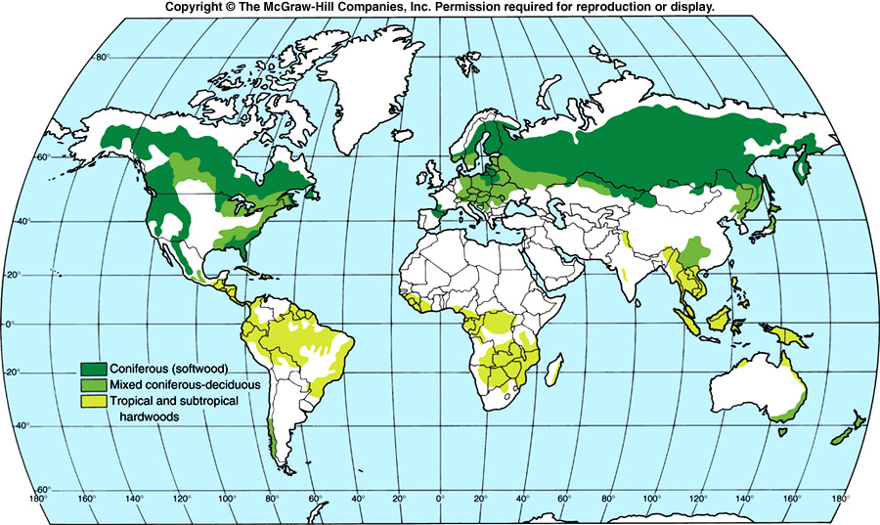

Slide 17
Resource-based economies
Multiple scales (from countries to towns)
Dependent on one commodity
Volatile commodity prices
Boom-and-bust cycles
Need value-added activity

Slide 18
Secondary economic activity
Adding value to primary products
Manufacturing, processing, energy, construction

Slide 19
Where does industry locate?
Situation factors
Cost of carrying inputs vs. outputs
Accessibility to different modes
Site factors
Cost of land
Cost and skill of labor
Availability of capital
Notes:
Situation- the location of a place relative to another place.
Site – The physical character of a place.

Slide 20
Five location factors
Raw materials
From primary activity or manufactured goods
Most important when:
Bulky or heavy inputs
Lose weight in processing
Perishable inputs

Slide 21
Five location factors
Market
Final consumer or another firm
Most important when:
Bulky or heavy outputs
Weight added in processing
Perishable outputs

Slide 22
Five location factors
Energy
More important historically than today
Mills in Britain, New England, etc.
Labor
Price, skill, availability
Usually not mobile
Transportation
Costs vary by mode, distance, transfers

Slide 23
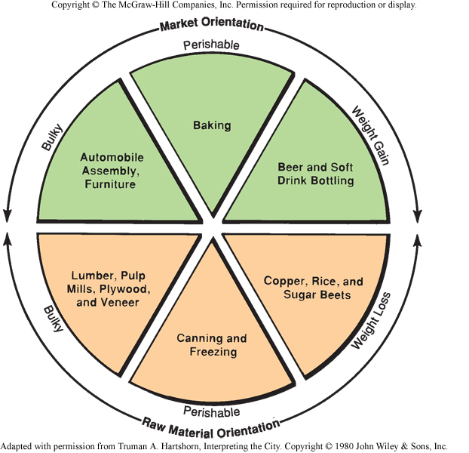
The graph on the right shows where a particular industry would be most likely to locate based upon the inputs of the product being manufactured. Can you think of any possible exceptions to these locations?

Slide 24
Agglomeration economies
Economies of scale: producing additional units costs less than producing the first few
Benefits of concentrating many firms in one place
Benefits of concentrating many firms in one industry in one place
Notes:
Agglomeration – when many companies in the same industry cluster together in a relatively small area to draw from the same set of collective resources.

Slide 25
Three Types of Services
Consumer (services to indvidual consumers)
Retail
Personal (health care, education)
Business (services to facilitate other business)
Producer (F.I.R.E)
Transportation
Public (provide protection & security for the previous two)

Slide 26
Service Economy
What are the spatial patterns that emerge from this map? Does the percentage of activity derived from service economic activity correlate with economic development/prosperity?

Slide 27
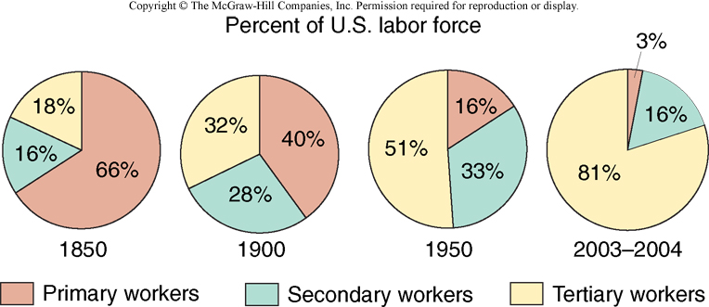
Shift in US Work Force
Why is there a shift in employment in the US over the past 150 years. What factors have driven this shift (think nationally and internationally)

Slide 28
Location in Services
Three geographic levels
Urban (choosing a city to locate in)
Choosing between cities
Neighborhood (choosing a part of the city)
Choosing a location within an urban area
Site (choosing the specific spot)
Choosing location within neighborhood

Slide 29
1. Urban
Income
Accessibility
Physical Infrastructure
Competition
Agglomeration
Consumers
Population
Demographics
City Image

Slide 30
2. Neighborhood
Population Density
Accessibility
Transportation Infrastructure
Income
Public Services
Incentives
Zoning Regulations

Slide 31
3. Site
Neighbors
Complimentary
Accessibility
Transportation Infrastructure
Traffic Patterns
Costs
Availability
Parking
Competition

