Slide 1
A quick guide to the factors of production
Economic Geography

Slide 2
Scarcity
Wants exceed availability
Something has more than one use
If something were free there would not be enough of it.
Scarcity is not a shortage

Slide 3
Scarcity
Wants exceed availability
Something has more than one use
If something were free there would not be enough of it.
Things that are scarce are desirable to ratioanl people.
Scarcity is not a shortage

Slide 4
Shortage
When demand is greater than supply.
A shortage can be graphed.
A shortage can be fixed by raising the price.
Scarcity is a permanent condition – it cannot be changed. EVERYONE experiences scarcity.

Slide 5
Things that are not scarce
Meaning even if it is free we will not run out of it…
Are puppies free?
Money is not scarce – it is a medium of exchange.
Notes:
No – eventually people will either take the puppies or the puppies will grow and become dogs, or they will die.

Slide 6
Things that are not scarce…

Slide 7
Things that are not scarce…
Notes:
Sunshine
Trash

Slide 8
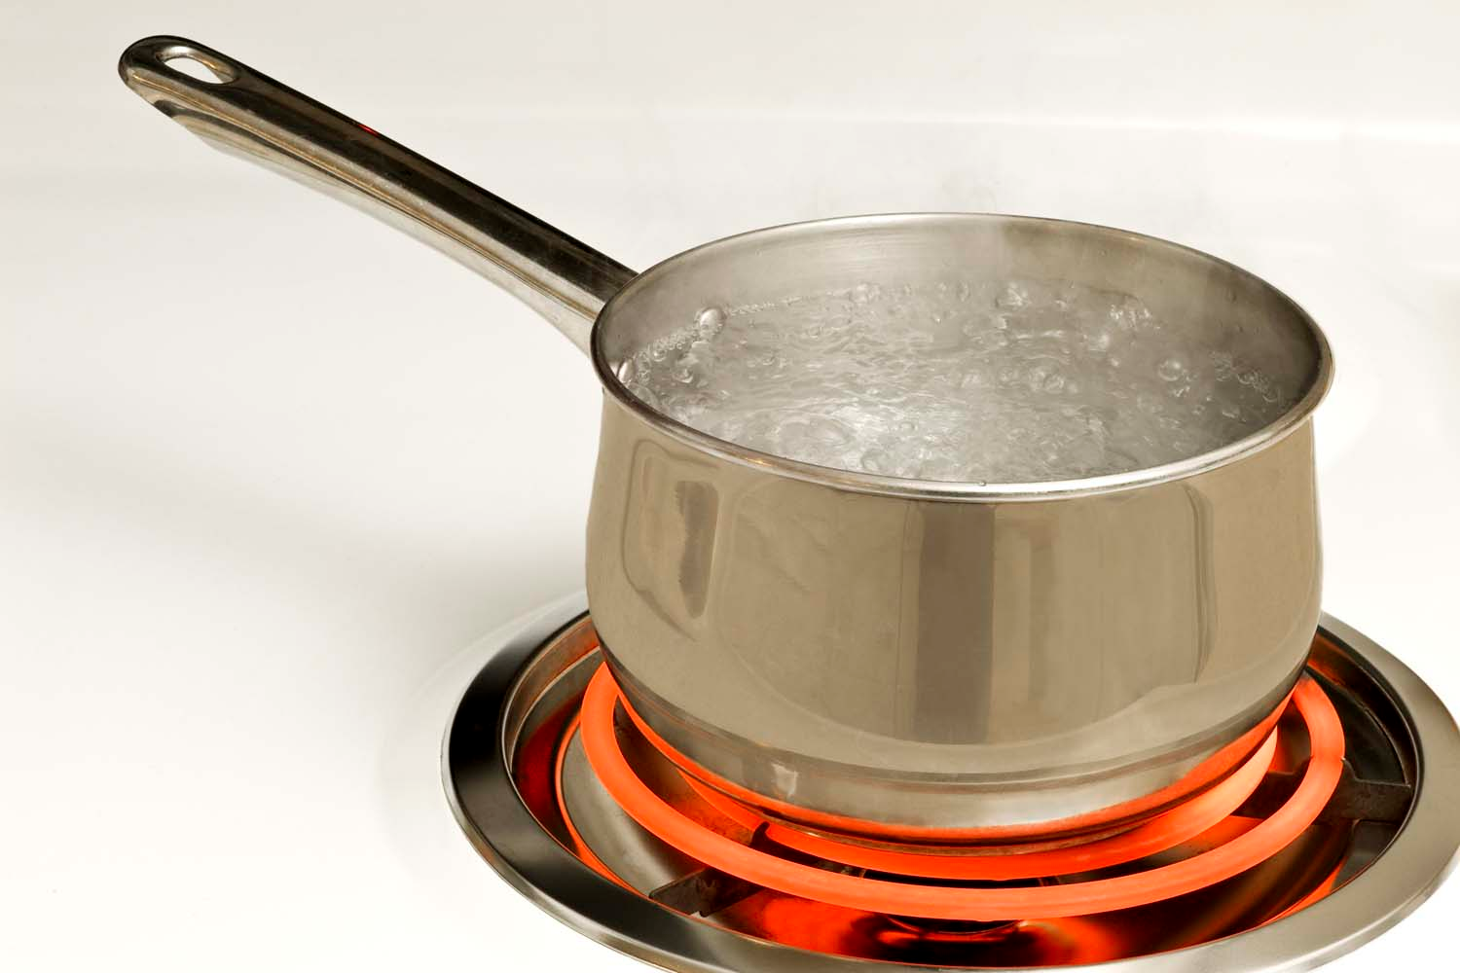
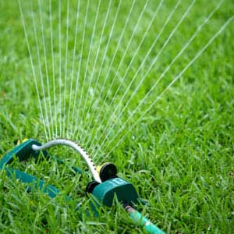
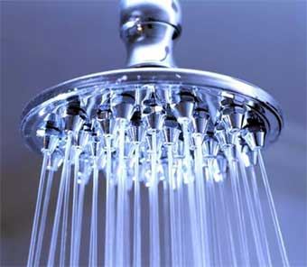
Things that are scarce
They have more than one use…
Notes:
Water – it has many uses and we have to decide how to use it…

Slide 9
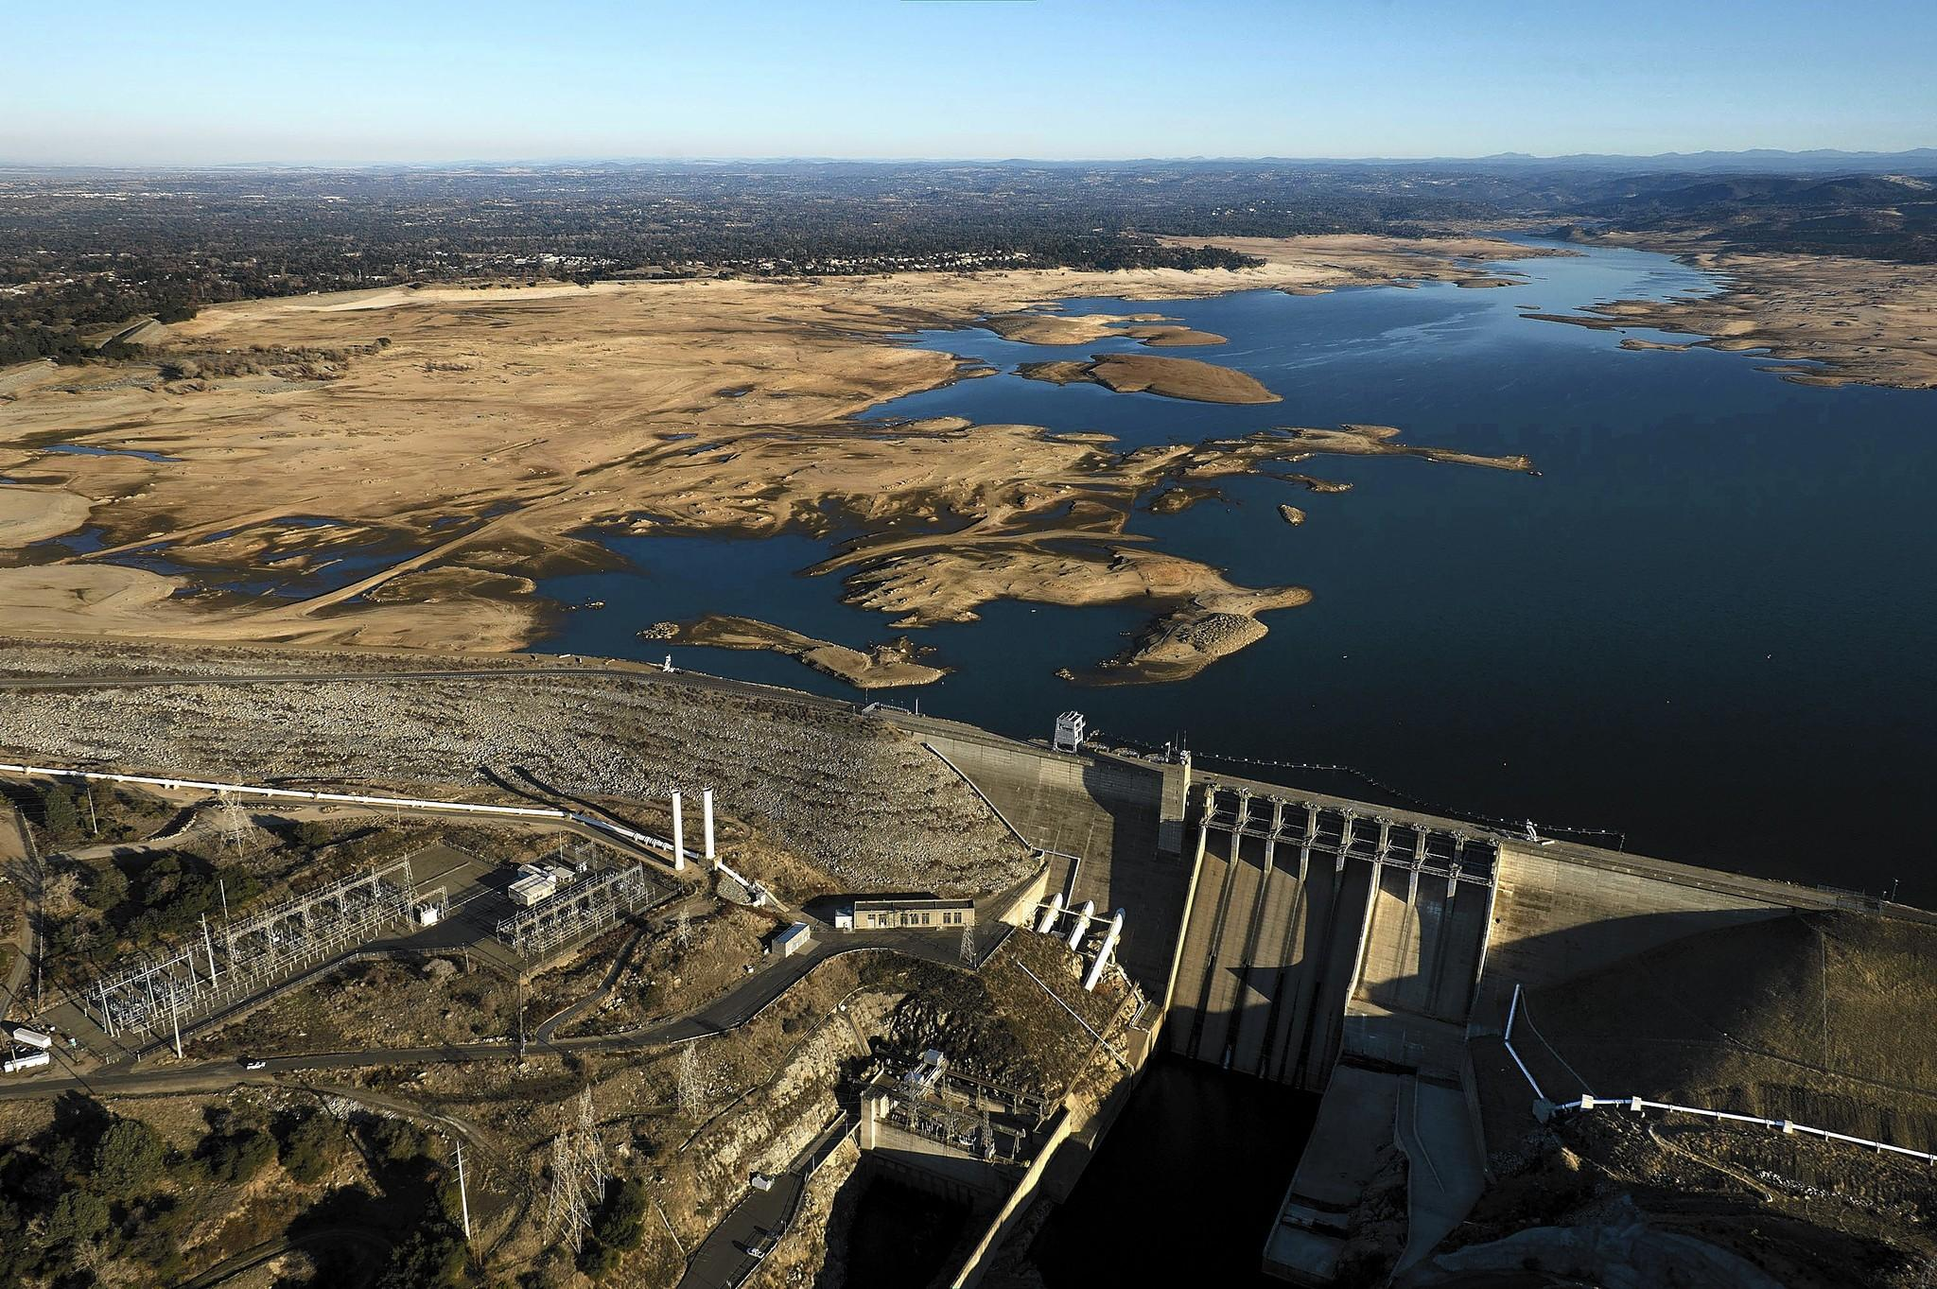
Things that are scarce…
Notes:
California reservoir
Some of the grimmest water measurements this year are from Folsom Lake on the American River northeast of Sacramento. The reservoir, above, is only 18% full, which is near a record low. (Randall Benton, Sacramento Bee)

Slide 10
Things that are scarce

Slide 11
Things that are scarce

Slide 12
Things that are scarce

Slide 13
Scarce or not?
Notes:
Hiking in the woods – not scarce
Treadmill scarce

Slide 14
Scarce or not?
Notes:
Mini van – scarce
Oxygen – not scarce item made scarce

Slide 15
In economics the factors of production are considered scarce.
Land
Labor
Capital

Slide 16
Factors of production:
Land - gifts of nature.
Water, corn, gold. Are all example of land.

Slide 17
Factors of production:
Labor -The work people do.
A farmer, teacher, pilot, fireman, singer.

Slide 18
Factors of production:
Capital – the tools used to make goods and services.
A tractor, sewing machine, paper.
Now your book says money is capital – NOT and in economic sense. But since geographers are not economists they get this messed up all the time. Financial capital is money – tolls used to make goods and services are capital.

Slide 19
Factor of production
There are two types of capital
Human – skills people have. Your ability to read is human capital.
Physical – machines and tools. Your pencil is physical capital.
What is Peyton Manning’s human capital?
What is his physical capital?
Notes:
Matt Duchene

Slide 20
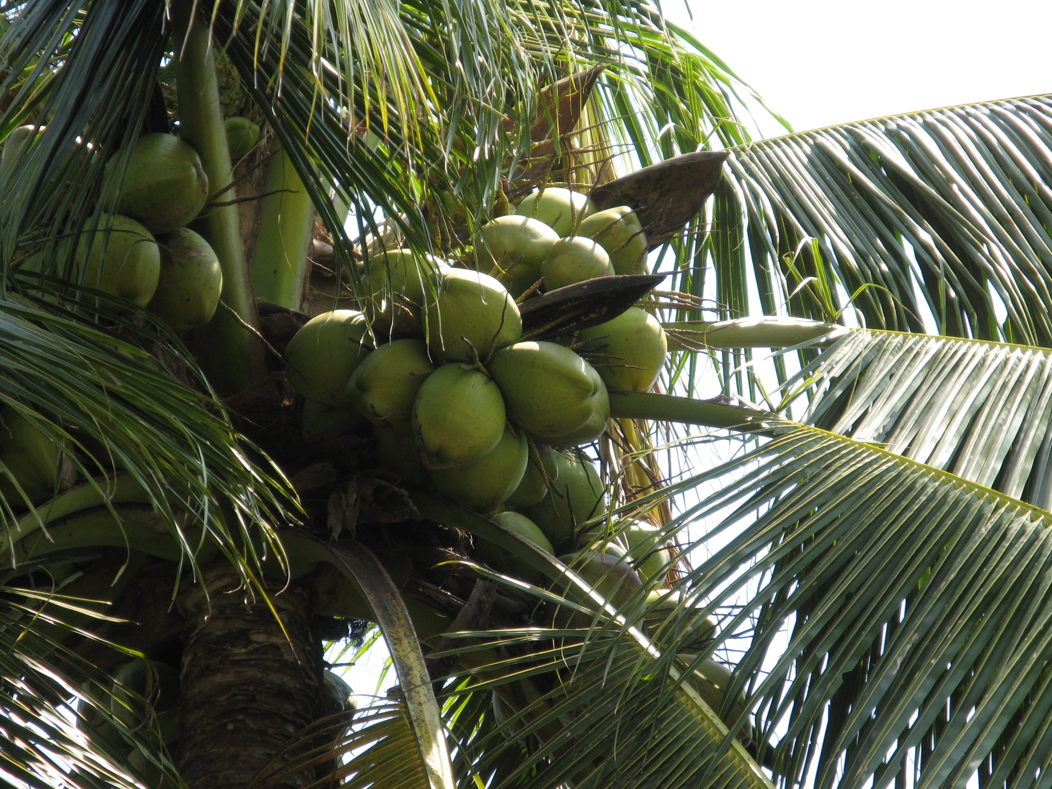
Land, labor or Capital?
Notes:
Coconut trees land

Slide 21
Land, labor or Capital?

Slide 22
Land, labor or Capital?

Slide 23
Land, labor or Capital?
Notes:
Capital – oil refinery

Slide 24
Land, labor or Capital?
Notes:
Labor

Slide 25
Land, labor or capital?
Notes:
Capital

Slide 26
Activity
What are the factors of production that go into an APHG student?

Slide 27
Activity
Give two examples for each FOP.
Land – example?
Labor – example?
Capital – example?

