Slide 1
POPULATION AGGLOMERATIONS

Slide 2
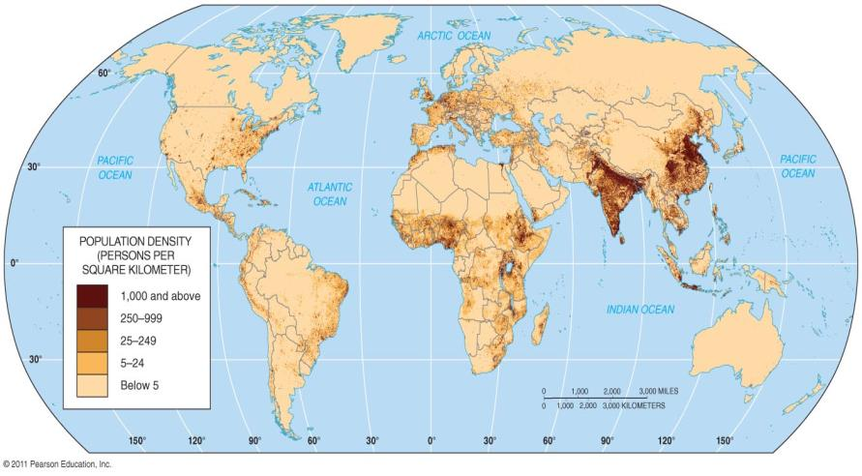
THE WORLD’S INHABITANTS ARE CLUSTED IN FOUR REGIONS.

Slide 3
THE WORLD’S INHABITANTS ARE CLUSTED IN FOUR REGIONS.
EAST ASIA
China, Japan, Korean Peninsula

Slide 4
THE WORLD’S INHABITANTS ARE CLUSTED IN FOUR REGIONS.
South Asia
India, Bangladesh, Pakistan, Sri Lanka

Slide 5
THE WORLD’S INHABITANTS ARE CLUSTED IN FOUR REGIONS.
SOUTHEAST ASIA: Indonesia (Java, Sumatra, Borneo) the Philippines, Papua New Guinea

Slide 6
THE WORLD’S INHABITANTS ARE CLUSTED IN FOUR REGIONS.
EUROPE: England, Germany, Belgium

Slide 7
TWO ADDITIONAL CLUSTERS
Northeastern US / SE Canada: Boston to New Port News, VA, to the Great Lakes and Chicago

Slide 8
TWO ADDITIONAL CLUSTERS
Western Africa: Nigeria, Togo, Benin. Ghana

Slide 9
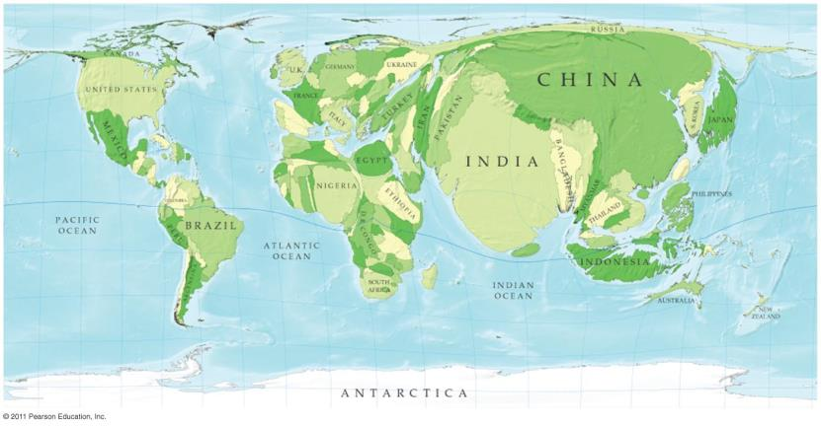
Why is it important to know where areas of large population density are located?
Notes:
Helps to explain why population is growing at different rates in different places. It indicates parts of the world that might be facing an overpopulation.

Slide 10
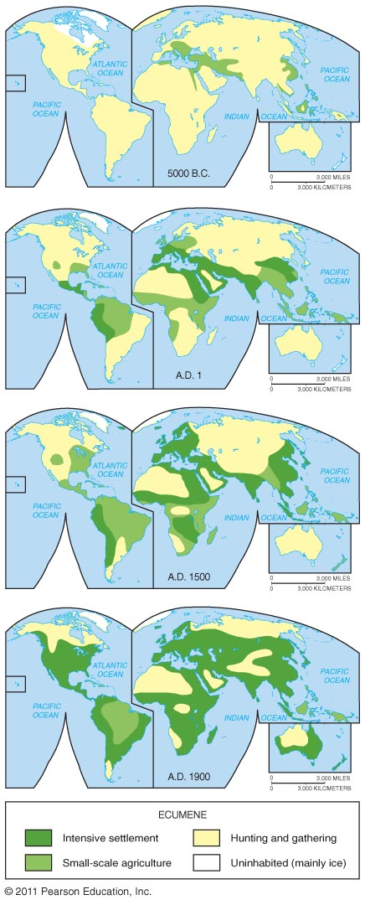
Why is it important to know where areas of low population density are located?
Notes:
It can indicate areas of harsh climate conditions. Also, indicated areas of future growth if technology improves and allows it.

Slide 11
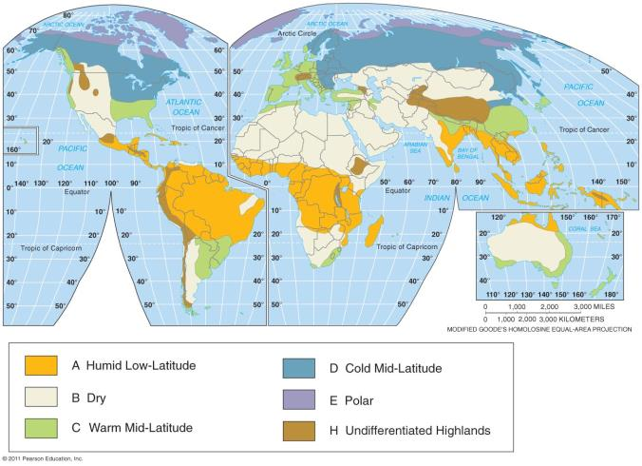
DO NUMBER 1 ON THE BACK

Slide 12
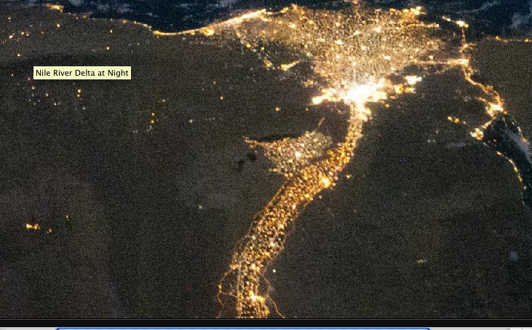
ARITHMETIC DENSITY – (Pop density) Misleading measure of distribution of people because the total number of people divided by the total land area See Egypt example 75 people per square km, but most people live by the Nile.

Slide 13
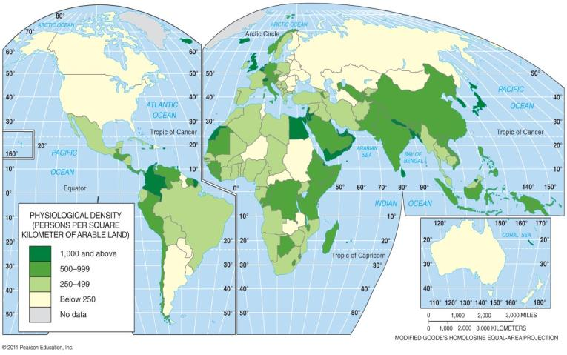
PHYSIOLOGICAL DENSITY – More useful measure because it is the number of people supported by a unit of area of arable land. Physiological density of Egypt is 2,580 people per square km. This shows pressure on the agricultural land.

Slide 14
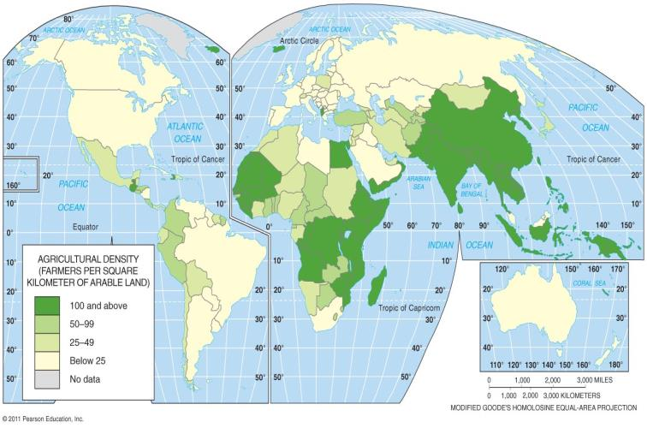
AGRICULTURAL DENSITY – Ratio of the number of farmers to the amount of agricultural land. Countries like the US and Canada have a much lower agricultural density than an LDC like India or Bangladesh

Slide 15

THE WORLD’S INHABITANTS ARE CLUSTED IN FOUR REGIONS.
EAST ASIA

