Slide 1
The Urban Game
Industrial Revolution

Slide 2
Directions:
In assigned groups. Pod up your desks to make a suitable writing surface.
Use a pencil. Colored pencils are acceptable.
It is crucial that size for each of the “characters” in the city be the same.
Put a compass rose on your paper in the corner.

Slide 3
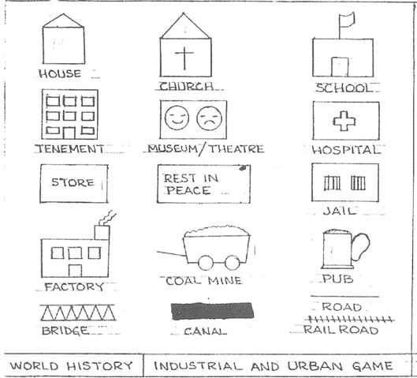

Slide 4
The year is 1700 and the nation is England. The scene is a rural village.
Draw a river across your paper connecting east to west; the river should be about 1 inch wide; draw a simple wooden bridge crossing the river; draw 2 roads one running north to south and crossing the river at the bridge and one running from east to west. Neither road need be a straight line. Draw 10 houses; 1 church; 1 cemetery; 1 store; 1 pub; 1 coalmine; & at least 50 trees!!

Slide 5
Draw a river across your paper connecting east to west; the river should be about 1 inch wide; draw a simple wooden bridge crossing the river; draw 2 roads one running north to south and crossing the river at the bridge and one running from east to west. Neither road need be a straight line. Draw 10 houses; 1 church; 1 cemetery; 1 store; 1 pub; 1 coalmine; & at least 50 trees!
Life here in our rural English village is similar to other villages throughout Europe in the 18th century. Change traditionally comes very slowly. People moved at a much slower pace and had access to very little information about the world outside their village. London, England’s largest city and one of the two real cities in Europe had a population of about 750,000 in 1750. Three out of every four Englishmen were rural and lived in small villages like this one.

Slide 6
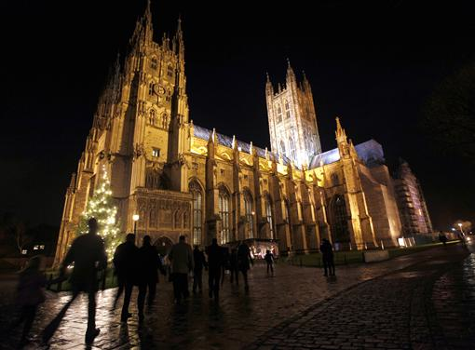
Draw a river across your paper connecting east to west; the river should be about 1 inch wide; draw a simple wooden bridge crossing the river; draw 2 roads one running north to south and crossing the river at the bridge and one running from east to west. Neither road need be a straight line. Draw 10 houses; 1 church; 1 cemetery; 1 store; 1 pub; 1 coalmine; & at least 50 trees!
The average village was inhabited by about 200-400 people. The tallest structure in the village was the church. The religion of England is Anglican (Church of England). Home life & work life were closely integrated as most work was done in nearby fields or in the home or perhaps adjoining workshop. The family was an economical unit as well as a social unit. Every member of the family worked very hard from sun-up to sun-down. Even small children had chores.
Notes:
Canterbury Cathedral, Church of England

Slide 7
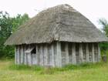
Draw a river across your paper connecting east to west; the river should be about 1 inch wide; draw a simple wooden bridge crossing the river; draw 2 roads one running north to south and crossing the river at the bridge and one running from east to west. Neither road need be a straight line. Draw 10 houses; 1 church; 1 cemetery; 1 store; 1 pub; 1 coalmine; & at least 50 trees!
The homes of villagers were very small with earthen floors and inadequate lighting and ventilation. All members of the family slept in the same room and sometimes shared living quarters with the livestock. Sons worked with their fathers farming and tending livestock while daughters worked with their mothers cleaning, cooking, sewing and at other domestic chores.
Notes:
Medieval housing – close enough to village housing in my mind.

Slide 8
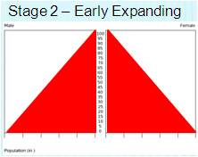
Draw a river across your paper connecting east to west; the river should be about 1 inch wide; draw a simple wooden bridge crossing the river; draw 2 roads one running north to south and crossing the river at the bridge and one running from east to west. Neither road need be a straight line. Draw 10 houses; 1 church; 1 cemetery; 1 store; 1 pub; 1 coalmine; & at least 50 trees!
Life expectancy was slightly over 40 years of age. Most people married in their teens and had babies before they were 20. It was common for women to die during childbirth so the average marriage lasted about 15 years. Step mothers and step fathers were common. One baby out of three died before their first birthday, only one child in two saw their 21st birthday.
Notes:
Stage 2 population pyramid

Slide 9
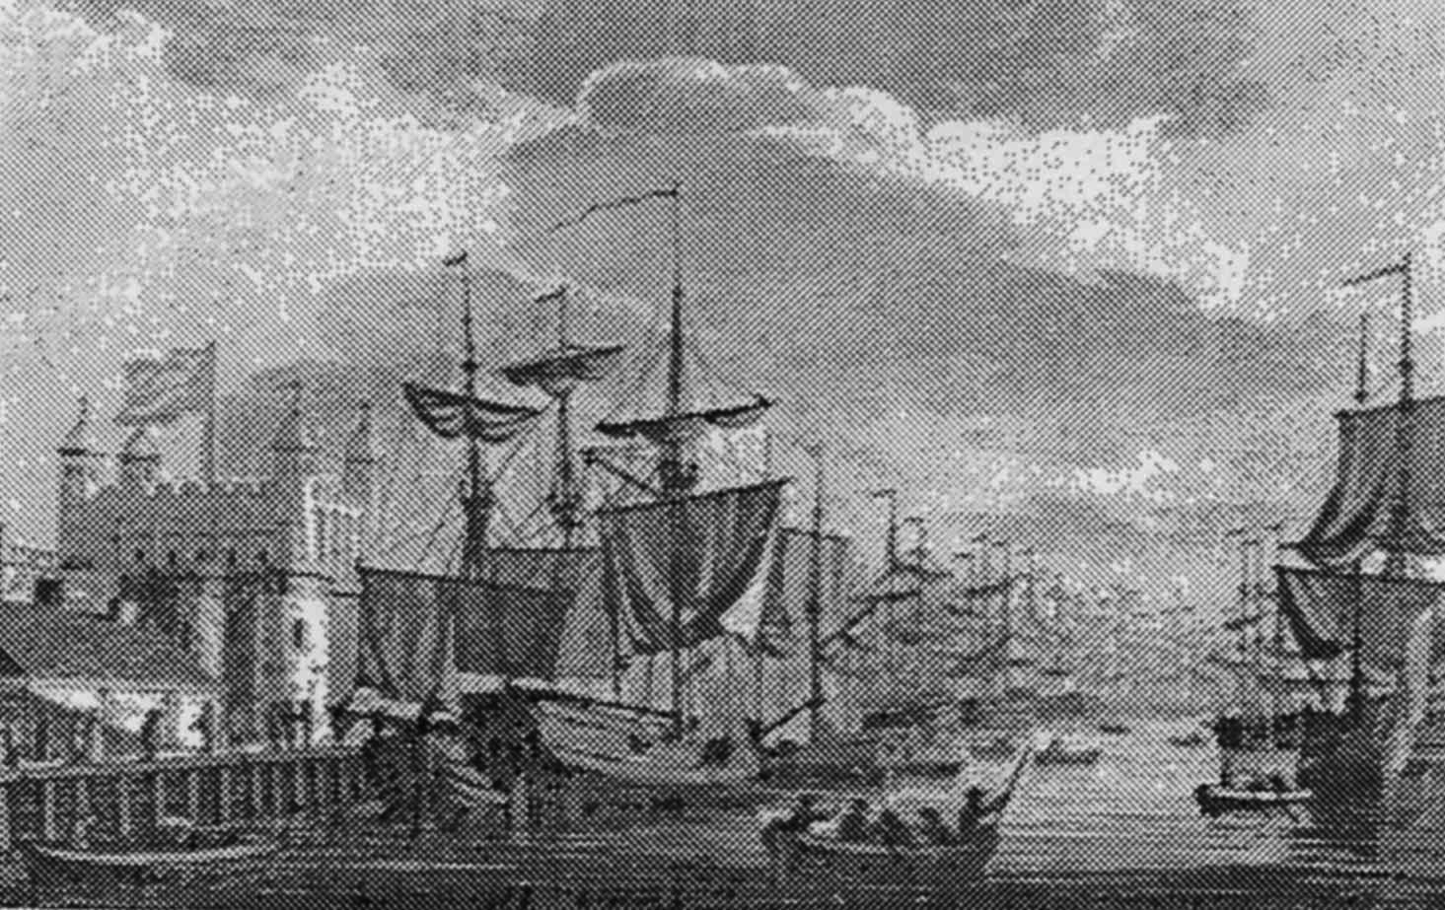
Draw a river across your paper connecting east to west; the river should be about 1 inch wide; draw a simple wooden bridge crossing the river; draw 2 roads one running north to south and crossing the river at the bridge and one running from east to west. Neither road need be a straight line. Draw 10 houses; 1 church; 1 cemetery; 1 store; 1 pub; 1 coalmine; & at least 50 trees!
Unlike France, the English were not rigidly divided into social/legal Estates. However, there was a distinct social class system. Most English were poor farmers. A few were middle class like the bourgeoisie of France. They lived, for the most part in London. Still a small few were aristocrats and usually owned large tracts of land in the English countryside.
Notes:
London 1700

Slide 10
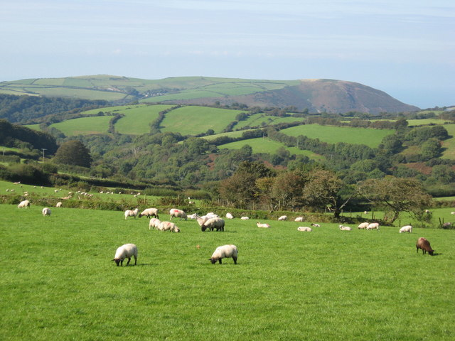
Draw a river across your paper connecting east to west; the river should be about 1 inch wide; draw a simple wooden bridge crossing the river; draw 2 roads one running north to south and crossing the river at the bridge and one running from east to west. Neither road need be a straight line. Draw 10 houses; 1 church; 1 cemetery; 1 store; 1 pub; 1 coalmine; & at least 50 trees!
For both peasant & aristocrats, the soil was the key to the economy. Land was the source of livelihood and well-being. Having enough land to produce adequate food, or to produce enough to sell, or even to rent was the key to economic survival.

Slide 11
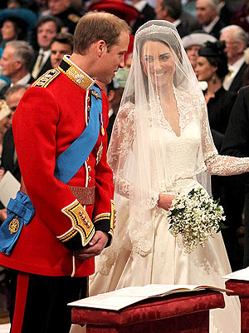
Draw a river across your paper connecting east to west; the river should be about 1 inch wide; draw a simple wooden bridge crossing the river; draw 2 roads one running north to south and crossing the river at the bridge and one running from east to west. Neither road need be a straight line. Draw 10 houses; 1 church; 1 cemetery; 1 store; 1 pub; 1 coalmine; & at least 50 trees!
Traditions concerning land guided daily living. These traditions were designed to ensure the stability and welfare of the greater community. Hence marriages and inheritance were geared to maintaining family property intact. Marriages were always arranged by parents to maintain or better the economic status of their sons or daughters.
Notes:
Kate and William

Slide 12
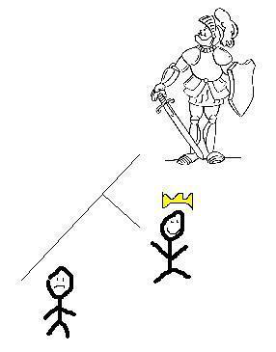
Draw a river across your paper connecting east to west; the river should be about 1 inch wide; draw a simple wooden bridge crossing the river; draw 2 roads one running north to south and crossing the river at the bridge and one running from east to west. Neither road need be a straight line. Draw 10 houses; 1 church; 1 cemetery; 1 store; 1 pub; 1 coalmine; & at least 50 trees!
Not all could get married however. A man had to generally own land on which to support a family before he dared to marry. It was not uncommon for men to wait until their 30s’ when they inherited property from their parents which enabled them to marry. If a woman did not bring land into marriage, she had to have some kind of dowry. Daughters who inherited property from their parents had to pass it on to their husbands. All land was given to the eldest son (primogeniture) while younger sons might receive cash payments or wait for their older brother to die.

Slide 13
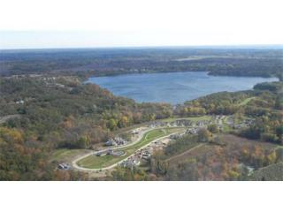
Draw a river across your paper connecting east to west; the river should be about 1 inch wide; draw a simple wooden bridge crossing the river; draw 2 roads one running north to south and crossing the river at the bridge and one running from east to west. Neither road need be a straight line. Draw 10 houses; 1 church; 1 cemetery; 1 store; 1 pub; 1 coalmine; & at least 50 trees!
The main occupation of England was farming. Private and public lands were not separated by fences as they are today. Every village had a public area called the commons. This was land which was available to anyone for pasturing, hunting, the gathering of fire wood, growing of crops, etc...

Slide 14
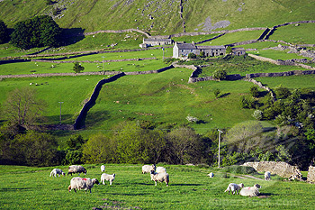
Draw a river across your paper connecting east to west; the river should be about 1 inch wide; draw a simple wooden bridge crossing the river; draw 2 roads one running north to south and crossing the river at the bridge and one running from east to west. Neither road need be a straight line. Draw 10 houses; 1 church; 1 cemetery; 1 store; 1 pub; 1 coalmine; & at least 50 trees!
So poor farmers who did not own their own land, or rented, could eke out a marginal living by depending on the commons. Unlike France, most English peasants or farmers did own their own land, however small.

Slide 15
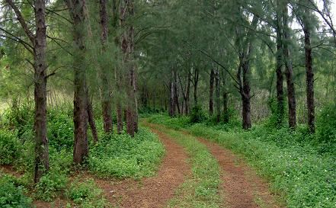
Draw a river across your paper connecting east to west; the river should be about 1 inch wide; draw a simple wooden bridge crossing the river; draw 2 roads one running north to south and crossing the river at the bridge and one running from east to west. Neither road need be a straight line. Draw 10 houses; 1 church; 1 cemetery; 1 store; 1 pub; 1 coalmine; & at least 50 trees!
Villages were connected by a system of dirt roads that became almost impassable during the wet season. As a result, transportation was often slow and trade beyond the village was not easy. Most English farmers never visited any place further than 25 miles from their birthplace, ever! People made their own food, clothes, furniture, tools, and homes. A few items which could not be produced could be obtained from wandering peddlers who also brought with them news.

Slide 16
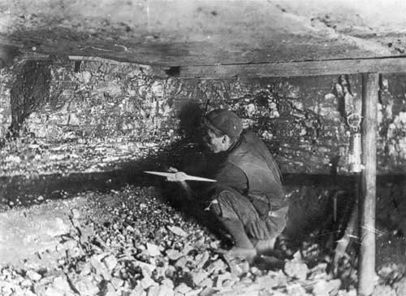
Draw a river across your paper connecting east to west; the river should be about 1 inch wide; draw a simple wooden bridge crossing the river; draw 2 roads one running north to south and crossing the river at the bridge and one running from east to west. Neither road need be a straight line. Draw 10 houses; 1 church; 1 cemetery; 1 store; 1 pub; 1 coalmine; & at least 50 trees!
Finally for fuel, there were two sources: Firewood & coal. Nearly every English village had a coal mining operation. These mines employed a small number of village dwellers, especially in the winter. Coal pits from which coal was extracted belonged to the owner of the property where the coal mine was situated.

Slide 17
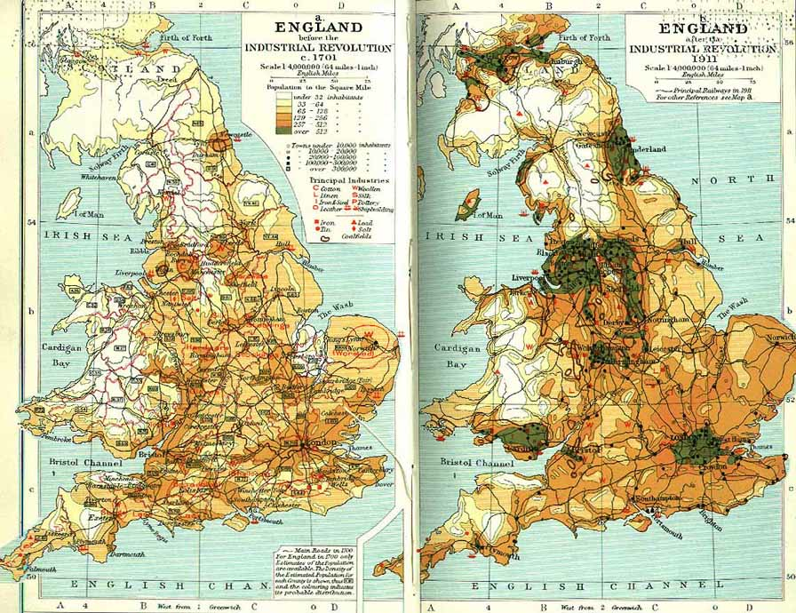
Draw a river across your paper connecting east to west; the river should be about 1 inch wide; draw a simple wooden bridge crossing the river; draw 2 roads one running north to south and crossing the river at the bridge and one running from east to west. Neither road need be a straight line. Draw 10 houses; 1 church; 1 cemetery; 1 store; 1 pub; 1 coalmine; & at least 50 trees!
Over the next 100 years, a revolution as significant as the Neolithic Revolution (when early man turned from hunting and gathering to agriculture) will completely change life in your village. Some historians believe this revolution (the industrial) is the most fundamental change in human history. We will experience some of these changes in the next few hours.
Notes:
Green represents population over 512 per square mile.
Orange is 257 – 512 per square mile.

Slide 18
Round 1
It is now 1745. England’s geography is unique in that no section of the country is more than 90 miles from the sea and there are many navigable rivers that crisscross the countryside. An enterprising young capitalist (you) decides to invest money in the construction of a canal. This is not a public venture but rather a private one. The profits from your canal are astonishing! For example, one canal built in 1745; the Oxford Canal yielded a 300% annual return for its investors for a period of more than 30 years. This new revolution in transportation reduced the price of raw materials and reduced the cost of transportation drastically. Coal could now be transported from the mines to the towns for half the price of horse-wagon transportation. Since you invested your money, thereby making a tidy profit:
build yourself 1 nice home anywhere on the map you would like it to be. Don’t forget to construct the canal. It must run parallel to the river.

Slide 19
Round 2
It is now 1750. For a variety of different reasons (soap, diet, sanitation, etc.…) there is a population explosion in England, and your village. The cursed Bubonic Plague which for centuries wiped out your village has been virtually eliminated due to the disposal of sewage in the canals and then ultimately the ocean.
Add 5 houses (total 15).

Slide 20
Round 3
It is 1760. The people of your village need a bit more food and goods to meet the needs of the new inhabitants. Coincidentally, a number of other noteworthy events occur around 1760. First, a number of new mechanical inventions for farming are developed. Perhaps the greatest impact was Jethro Tull’s creation of the seed drill and the horse drawn cultivator. Also, farmers begin to experiment with new, more productive framing practices like crop-rotation, new fertilizers, & new livestock breeding techniques. Consequently farm production is significantly increased. But there is one problem. Most farmers own one tract of land. Why should they, or how could they, invest in expensive machines when their land is so small? What’s more, it’s almost impossible to buy land from anyone! At the same time, pressure is placed on Parliament by large and small landowning farmers to make more land available. Where is that land coming from? The Commons of course! A series of laws call the Enclosure Acts are passed by Parliament. This means that landowners can buy pieces of common land from the government
Fence off an area 3x3 inches to be reserved as a commons. Add 5 houses (total 20) and 1 more nice house.

Slide 21
Round 4
It is now 1773. A man named Richard Arkwright invents a new machine that can spin and weave cloth a hundred times faster than could be done by hand in a farm cottage ( the most common way of producing cotton cloth up to this time; the cottage industry ( putting-out system). He calls his new machine the Water Frame because its principle source of power was water. Let’s imagine that the first water frame was built in your village (because of the river). Since the water frame was large, a special building was needed and thus, the first factory for producing cotton cloth was built. Add 1 factory (no smoke—it is powered by water). Remember, the cotton factory must be placed on the river bank. Canal water is not swift enough to generate the power to the working parts of the water frame. Don’t add any smoke to this factory!! Add 5 houses for workers (total 25)

Slide 22
Round 5
It is now 1774. Workers are needed to work in this new factory. Since many people (women) cannot compete with the spinning and weaving of cloth made in the factory and there are large numbers of poor families who have lost their livelihood due to the Enclosure Acts, we do have an available supply of workers. People move to your village to find work.
Add 15 houses (total 40); 1 church , 1 pub, & 1 store. You may draw additional roads and 1 additional bridge.

Slide 23
Round 6
The profits from the first textile factory are enormous. It should be no surprise that Richard Arkwright is referred to with two titles: The first millionaire and the father of the factory. New factories are built in your community: Add 5 new factories (must be on the river bank as they need water power). The early owners of these factories called themselves capitalists because they had the capital or money to purchase the raw material, the building, the water frame, and to pay their workers a fixed wage and make a profit. Add 5 houses (total 45)

Slide 24
Round 7
It is 1780. Unemployed workers from surrounding areas flood into your community looking for work. Although wages are very low, they look attractive to starving families. Housing is in great demand and for the first time a new kind of housing is constructed called Tenements. Here dozens of families reside under one roof.
Add 5 Tenements.

Slide 25
Round 8
It is now 1781. More workers need to live, eat, shop, drink, worship. We need the social support services to go along with the demand. Add 1 store, 1 pub, 1 church, & 1 school for those families wealthy enough to send their children (boys) to school. Since workers in the factories work 6 days a week, the only day of rest is Sunday. People flock to your churches so make them convenient for their tired feet.

Slide 26
Round 9
It is now 1782. Workers work long, hard hours in the factories. The average work day begins at 6:00 a.m. and ends at 9:00 p.m. There is only a 30 minute break for lunch. After work, exhausted, “stressed out” workers stop at their local pub for some relaxation. Alcohol begins to be consumed throughout England in record amounts.
Add 5 more pubs. Destroy 5 houses (total 40), add 4 tenements.

Slide 27
Round 10
It is now 1783. Workers barely eke out a marginal existence. There is never enough money to save and some workers go into debt. Few, if any, could afford to send their children to school. Still, there are a few families whose lifestyle is quite comfortable, even luxurious. Who are they? They are the large landowning farmers and factory owners. Add 2 special homes. Handsome manor houses are built and some are lavishly furnished with art. These new rich (nouveau riche) are not part of the aristocratic class of England but they now can enjoy some of the refinements of the aristocratic rich such as food, servants, furniture, education, fine clothing, carriages, etc….Add 1 factory, add 15 houses for management personages (total 55) (Note: from this point on trees may be removed if you need space).

Slide 28
Round 11
The year is 1785. A man named James Watt invents a new machine called the steam engine. The steam engine replaces the water frame. First, it is far more efficient. Second, it allows factories to be built away from the river. This source of power is more mobile. Capitalists quickly replace their water frames with steam powered weaving and spinning machines. The main business in England is still textile manufacturing.
Add 10 factories with smoke. Add smoke to all other pre-existing factories. Also, add one nicer house since people continue to get rich. Add 5 houses (total 60) and 1 tenement.

Slide 29
Round 12
The year is 1800. A man named Henry Cort has just invented the puddling process. This process makes it possible for coal, which is, fortunately, in abundant supply in England, to be used as the primary fuel in the new iron industry. Consequently, your town is thrust into the “New Age of Heavy Industry”. Larger factory districts appear which manufacture iron at low prices and that can easily be transported by your canal.
Add 1 new coal mine and a new iron bridge to replace the old wooden one. Add 5 houses (total 65).

Slide 30
Round 13
The year is 1815. Coal miners are busy mining coal. There is a great demand for coal right now: home-heating, fuel for the steam engines, for the production of iron. Add another coal mine. Although in the 1700’s coal miners were adults who worked in the winter to supplement their wages, in the 1800’s they are typically children between the ages of 8 and 14. The work is dangerous and unhealthy. Children become victims of black lung, explosions, & accidents. Their growth is stunted as they spend their 14 hour day stooped over. They are malnourished and unable to exercise or eat properly. Casualty rates go up.
Draw 1 cemetery.

Slide 31
Round 14
It is 1820. The existing canals and dirt roads cannot accommodate the heavy industrial traffic. New experiments with transportation using the power of a steam engine are tried. The most successful appears to be a steam engine that pulls a series of wagons or cars on an iron track. The first railroad is tested and proves to be quite effective. Add 1 major railroad line connecting all your factories to your coal mines. This is one continuous track which must connect all factories and mines (you may build additional railroad bridges only as needed).
Add 5 houses (total 70) for railroad builders.

Slide 32
Round 15
It is 1827. This new “revolution” in transportation draws thousands of people to your community. Soon there becomes a surplus of workers. Capitalists who wish to ensure their profits decide to hire women and children over men because can perform the same factory labor at one-half to one-quarter the price. More and more children leave their homes to work. Depressed, ashamed, and angry about their wives, and children toiling in factories, many men turn to crime, and the social life of the pub. For the first time in England’s history, alcoholism appears in epidemic proportions. Family life that existed for hundreds of years in England is disrupted. Family members seldom eat together or see each other.
Add 1 jail & 2 pubs and 2 tenements

Slide 33
Round 16A
It is 1835. Using steam engines, iron and soon steel, British manufacturers introduced power-driven machinery in many industries. The production of shoes, clothing, ammunition, and furniture became mechanized, as did printing and paper-making. People used machines to cut and finish lumber, to process foods, and to make other machines. Some new inventions and innovation processes had important by-products. These by-products often developed into separate industries. For example, iron smelters used coke, a by-product of coal, to improve the smelting process. Then someone discovered that the gases that coal released during the coke-making process could be burned to give light. During the 1830’s London and other large towns became the first communities to pipe in gas to burn in street lights. Soon all around England hundreds of towns used gas to light streets and homes.
Add 20 street lamps. (these are streetlamps and must be located along streets)

Slide 34
Round 16B
It is 1838. Let’s look at the working conditions in the factories. The two predominant factories are textile and iron (steel). Working conditions in either of these two were appalling. Many workers contacted the deadly factory fever or white lung disease. It was probably a variety of lung ailments: cancer, tuberculosis, emphysema, etc… Other workers were injured on the job in factory accidents. There were no protective railings around the huge moving mechanical parts of machinery. Children, weakened from lack of proper sleep or diet, stumbled into machinery and were mutilated. Women with long hair that became undone often found themselves caught in moving machinery. Regardless, if you were unable to work, you were fired. There was no health insurance. There was always a daily line of unemployed workers waiting to fill vacant jobs.
Add 2 hospitals and 1 more cemetery.

Slide 35
Round 17
It is 1840. There is a need for quicker transportation. Coal, iron, finished products, & raw materials must all be transported from one area of England to another. In Ireland in the late 1830’s a devastating potato famine drove hundreds of thousands of Irish to England. Here was the cheapest of labor possible to build more railroads.
Add 1 more railroad line passing east to west through your town. Add 5 houses (total 75) and 1 tenement for the new railroad workers.

Slide 36
Round 18
It is 1842. There are some advantages to urban dwellers. City life is very different from the country life. For the small but growing middle classes, a whole new cultural life is available. Museums, theater, opera, restaurants, plays, & concerts are made available. Whereas before only the aristocrats could afford the arts, but now the middle class enjoys the fine life of culture and good living.
Add 1 theater and 1 museum. Add 2 private schools for upper class students (mark these schools with the letter “P”. Add 1 nice house.

Slide 37
Round 19
It is 1845. There are no pollution controls so the air in your community looks dark. Windows, walls even trees are covered with layers of soot and coke. The river that once flowed through your quiet village for hundreds of years is now unfit for drinking, bathing, or laundry. A new disease begins to take the lives of people. Malignant tumors grow in peoples’ bodies and the term cancer is first used in the medical profession. The average life expectancy for the poor classes is now 30 years of age. Your city is overcrowded and shrouded in factory smoke. The noises, the loss of privacy, & the loss of the family unit shatters the peace of the old ways. Suicide rates double, then triple. Add 1 cemetery, 1 jail, 1 hospital to accommodate the victims of urban life.

Slide 38
Round 20
It is 1850. By this year several million acres of good English land has been enclosed and sold to private parties who own large estates. Despite the misery this creates for England’s landless poor, the economy benefits for the rich are obvious. These farmers purchase the newest power-driven machinery and can easily feed the working class of England (including the Irish). The small landowning farmer is crushed by the enclosed commons. They cannot afford the machinery and therefore cannot compete and grow food profitably. Thousands of these folk leave their villages (where their ancestors had lived for hundreds of years) and move to towns and cities looking for work to feed their families. Some refused to leave but took jobs working for the large landowning farmers. By the thousands, they moved to the bleak, uninviting towns of the north and the new cotton mills.
Add 20 houses (total 95), 5 tenements, 2 stores, 1 church, 5 factories, and 1 pub, and 2 more nice houses and one special house.

Slide 39
How does it look?
What are your thoughts about the Industrial Revolution?
Can you draw any conclusions based on the changes in your village over this time period?
Would you do anything differently?
Why didn’t the people of England do things differently?

Slide 40
Your Turn…
Using what you have learned about the evolution of a town, from a site along a fast flowing river to a bustling economic center, design a town “from scratch”.
Your town must include the following structures and spaces.

Slide 41
Your town…
1 river | 3 bridges
80 modest houses | 1 city hall
15 splendid houses | 1 museum
10 stores | 2 secondary schools (public)
3 primary schools | 20 tenements
1 bank | 1 hospital
5 pubs | 1 theater
5 restaurants | 3 churches
1 courthouse / jail | 2 cemeteries
10 factories (various sizes) | 2 parks
2 railroad lines, 2 stations | 1 library
8 streets with an intersection | 1 feed mill (Where farmers buy grain)
3 coal mines

Slide 42
Explain your rational for your town design…

