Slide 1
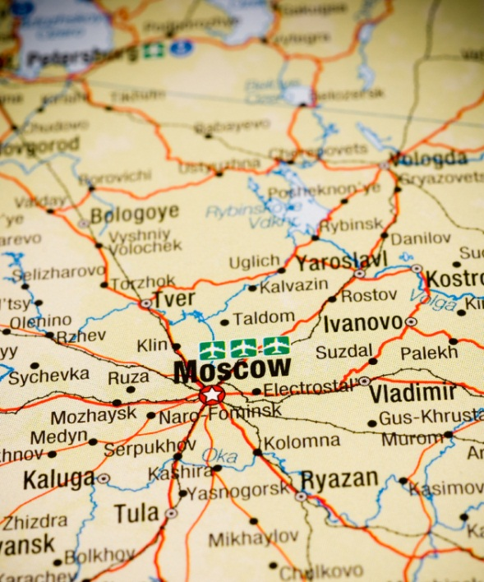
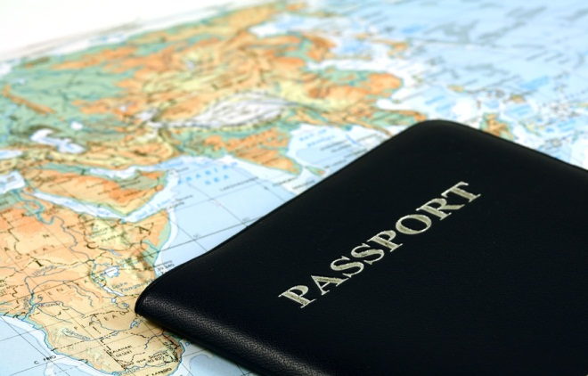
Cartography 101
The Basics of Maps, Map Making and Location

Slide 2
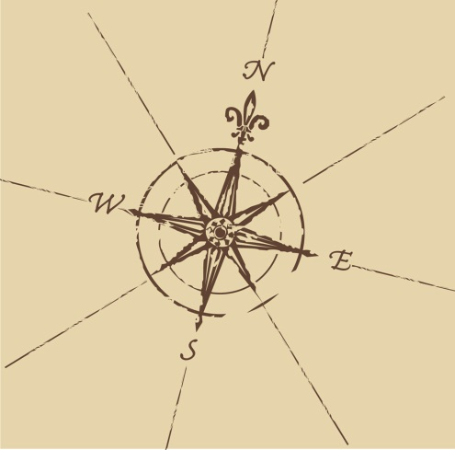
Map Basics
All quality maps have the following Basic Traits:
Title: gives the map purpose and thematic focus
Compass: gives cardinal directions & orientation
Key/Legend: decodes symbols or defines colors used
Scale: converts size on map to distances in real life
3 Types of Scales
Graphic Scale (drawn)
Written Scale ex: 1 inch = 5 miles
Representative Scale (RF) ex: 1:9,778,000
To convert into “Inches in a Mile”
1st divide # by 5280 (feet/mile)
2nd divide the answer by 12 (inches/foot) = How many miles in an inch.

Slide 3
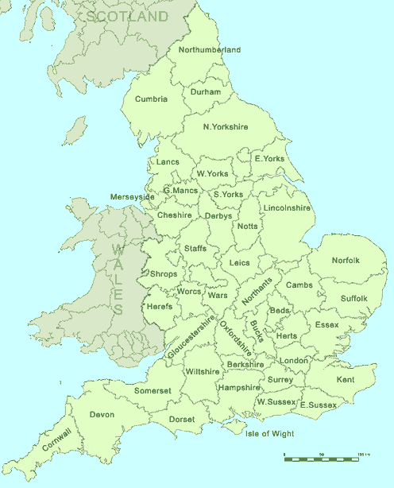
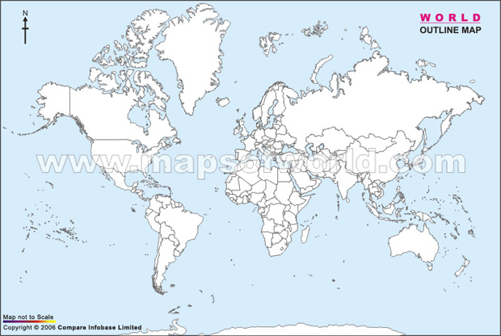
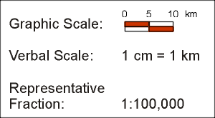
Reading Maps – which map has is large scale and which is small?

Slide 4
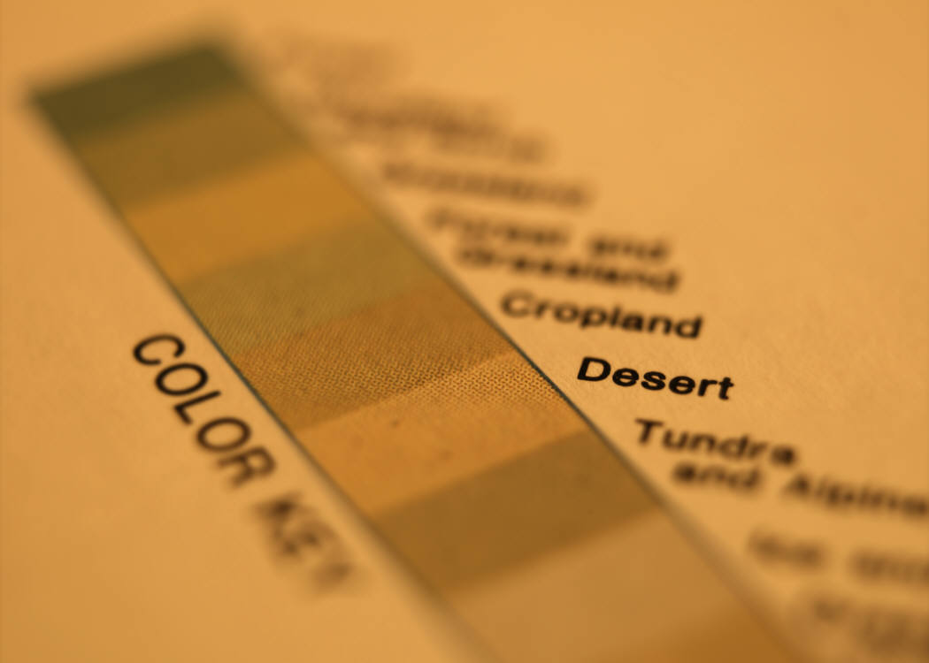
Color & Shading
Gives meaning to colors used:
population enviro-regions
borders
precipitation
**gradients**
In the picture above, color is being used to show what?
Find a map in your atlas that uses color differently…How it is used?

Slide 5
Map Projections
Go to reference pg. ix
3 most common map projections
Cylindrical Projection
Most accurate across the center (Tropical Regions)
Least accurate at the top & bottom
Conic Projection
Most accurate at the cone’s rim (N. America wide W>E)
Least accurate in the center/bottom of cone
Azimuthal – Planar Projections
Most accurate at the center (Polar Regions)
Least accurate at the edges

Slide 6
Relative Location
Relative: Where a place is located in relation to another known place
Which could be a….
Nation, landmark or physical feature (water or land)
Make sure that….
Your chosen features are close to the actual location

Slide 7
Examples:
Monarch High School is located to the North of 36, South of Dillon Rd and Southeast of Harper Lake
Japan is located to the East of China but South of Sea Okhotsk
Provide a relative description of your house using three relative landmark mix’em up!
(physical feature, well known building, street)

Slide 8
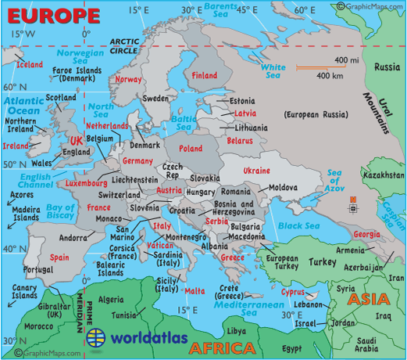
Provide a relative location for….

Slide 9
Absolute Location
Absolute: The exact latitude and longitude coordinates of a place
Divided into degrees first and minutes second
Example: Louisville, CO – 39° 58’N, 105° 08’W

Slide 10
Latitude
Latitude...
is measured North and South of the Equator
lines run East - West on the globe/map
lines are parallel to one another (never intersect)
Lines are NOT equal in length
Biggest @ Equator & Smallest @ N/S Poles
There are 90 latitude lines in each hemisphere
180 Total lines
Important Lines of Latitude
0° = Equator
90°N = North Pole
90°S = South Pole
23.5°N = Tropic of Cancer
23.5°S = Tropic of Capricorn
66.5°N = Arctic Circle
66.5°S = Antarctic Circle

Slide 11
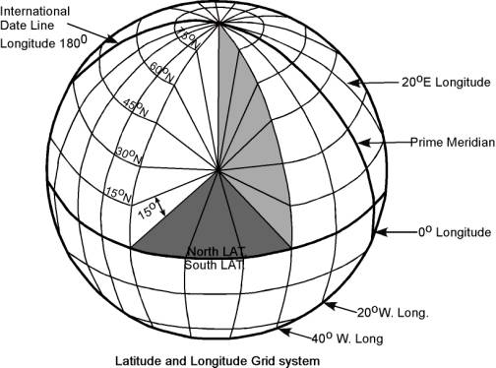
Longitude
Longitude...
is measured East and West of the Prime Meridian
lines run North - South on the globe/map
lines are equidistant to one another (intersect @ the Poles)
Lines are equal in length (all = to Equator length)
There are 180 longitude lines in each hemisphere
360 Total lines
Important Lines of Longitude
0° = Prime Meridian – Greenwich Meridian
180° = International Date Line
- Is not an exact Meridian because
it jogs around countries
-When you cross it you change the date
Youtube review! http://www.youtube.com/watch?v=swKBi6hHHMA&safety_mode=true&persist_safety_mode=1&safe=active

Slide 12
Practice
What is at....?
23° N, 72° E =
58° N, 30° E =
4° S, 105° E =
30° N, 81° W =
25° S, 57° W =
69° N, 30° W =
Ahmadabad, India
St. Petersburg, Russia
Palembang, Indonesia
Jacksonville, Florida
Asuncion, Paraguay
Mt. Gunnbjorn, Greenland
Google Earth – Miracle?
47.110579, 9.227568

Slide 13
Topography
Topography – topo – “place" + graphia - "writing" a place’s signature or mark
The variation of the earth’s surface showing natural features such as rivers, canyons, lakes, and most importantly, variations in ground elevations. Relief and terrain
Shows the contour of the land from plains and rolling hills to steep canyons and mountains
Lines are plotted in intervals of elevation change
ex: 250ft, 500ft or 1,000ft
Lines that are close together represent rapid or steep vertical change
ex: steep canyons walls or cliffs
Wide spaces between lines represent gradual or slow vertical change
ex: rolling hills, plains, valley floors, beaches
Students should be able to look at two locations and draw a vertical profile of the journey traveled
Topo your knuckles or simulate a false mountain
http://www.youtube.com/watch?v=DQPEIjhBdII&safety_mode=true&persist_safety_mode=1&safe=active

Slide 14
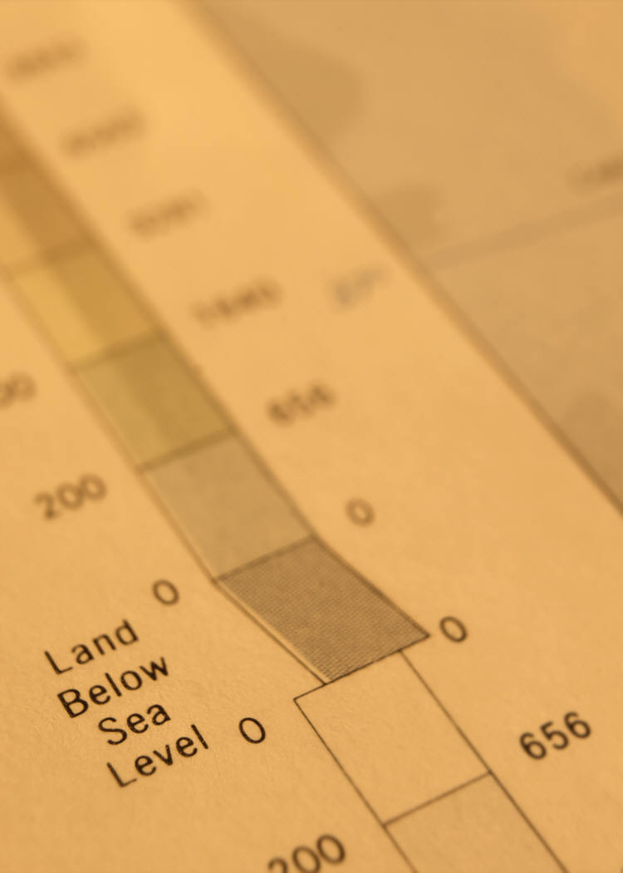
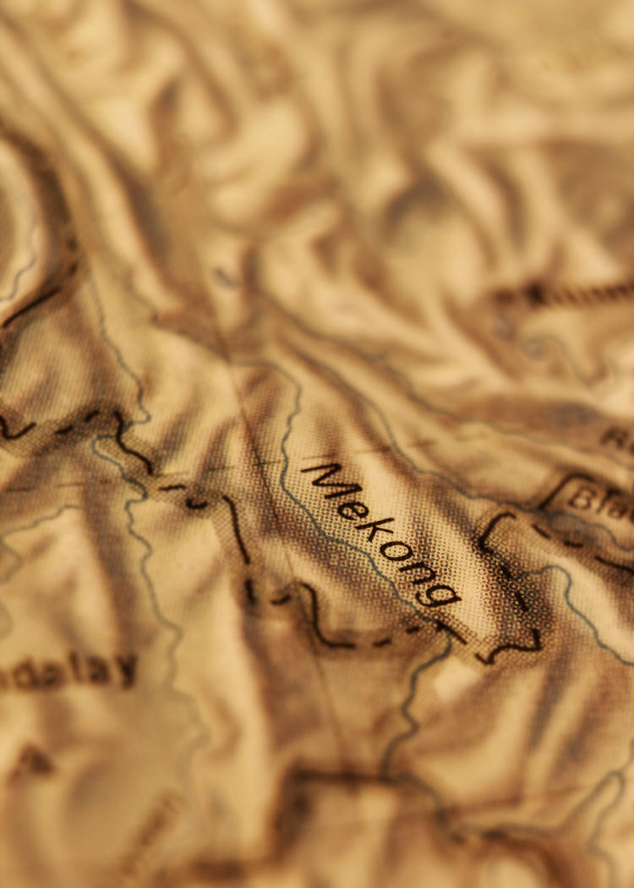
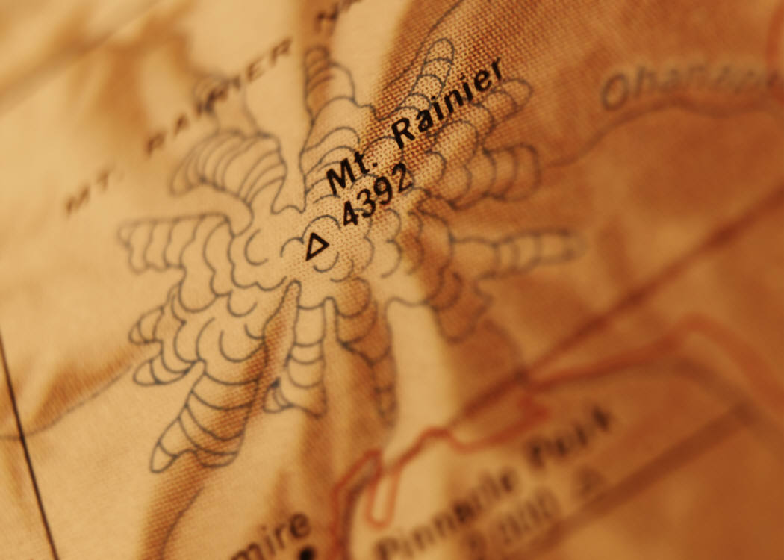
Topographic Maps USE:
Color to show elevation
Shaded relief
Contour lines to location of similar elevation

Slide 15
Physical vs. Political Maps
Physical Maps Include
* Major Landforms
-Mnt. ranges, peninsulas, etc.
-Escarpments, depressions
* Major Biomes/ Environ Regions
-Jungles, deserts, plains
-Altiplano, steppe, llanos
* Major Water Features
-Bays, oceans, seas, straits
-Rivers, lakes, reservoirs
-Waterfalls, rapids
* Elevation & Topography
-Shows relief of land
-Provides elevation examples
Political Maps Include
* Political Boundaries
-International Borders
-State, province, territory
-Disputed borders
* Major Cities & Towns
-Medium and Large
-Relative to population size
-    ● ◦ ·
-Capital city
* Infrastructure & Development
-Roads, Interstate highway
- Major railways, pipelines
- Urban Centers
-City & suburbs
-Large developed areas

