Slide 1
Thematic Maps
Types & Purpose

Slide 2
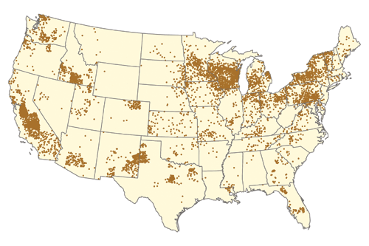
Dot Maps
Title of Map:
Where are the cows?
Short Description: Each dot on this map represents 1,500 cows (2011). Generally speaking, the country’s growth pockets are taking cows from somewhere else; not many areas are the same as they were in cow numbers 10 or 20 years ago. The U.S. continues to produce milk in all states — even Alaska and Hawaii. But the trends seem to show that dairy is concentrating into ever more dense pockets of production. The Southeastern quadrant of the country is about 40 billion pounds of milk net deficit annually and growing more so every year. Some of this is attributable to population pressures, but much can be blamed on genetic and management advances in milk yields that are hard to be realized in hot and humid climates
Source: http://www.hoards.com/13mar25-cow-islands

Slide 3
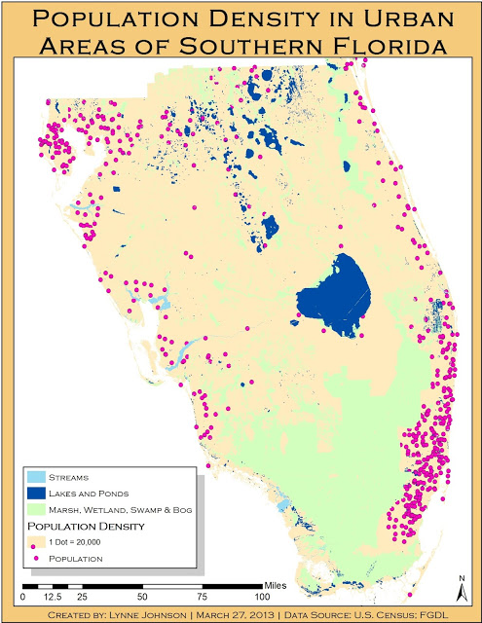
Dot Maps
Title of Map:
Population Density in Urban Areas of Southern Florida
Short Description: This map displays the population density of southern Florida using dots. Each dot represents 20,000 people. Since the study is of urban areas, dots only appeared in the urban areas. Lakes, streams, ponds, marshes, wetlands, swamps and bogs were included where no one is living to help clarify. Dots were bold and were a color that would stand out from the rest of the map.
Source: http://lej11.blogspot.com/2013/04/cartographic-skills-lab-11-dot-maps.html

Slide 4
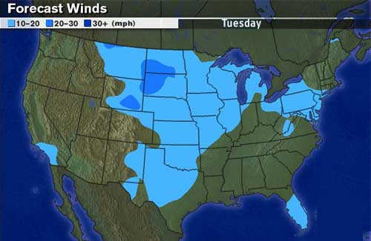
Isoline Maps
Title of Map:
Forecasted Winds
Short Description:
This isoline map shows areas predicted for higher forecasted winds than their surrounding areas. Although large areas are not colored we can assume that winds in these areas are below 10mph.
Source: http://www.kidsgeo.com/geography-for-kids/0034-isolines.php

Slide 5
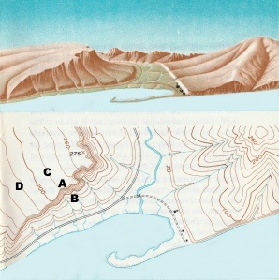
Isoline Maps
Title of Map:
Topography or Contour Map
Short Description: This dual-view map shows how points of common elevation are drawn onto a contour map. Isolines that are closer together (A/B) are steeper in slope than those farther apart (C/D).
Source: http://www.earthonlinemedia.com/ebooks/tpe_3e/essentials/isolines.html
(Courtesy USGS)

Slide 6
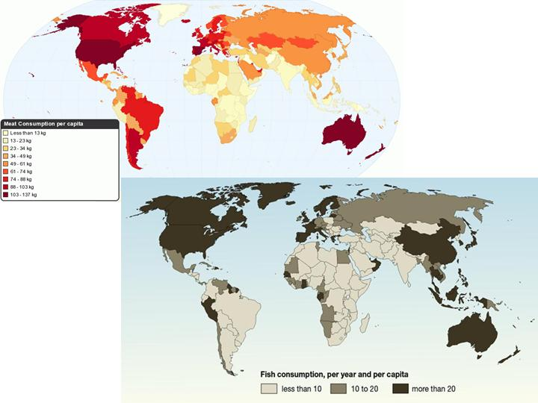
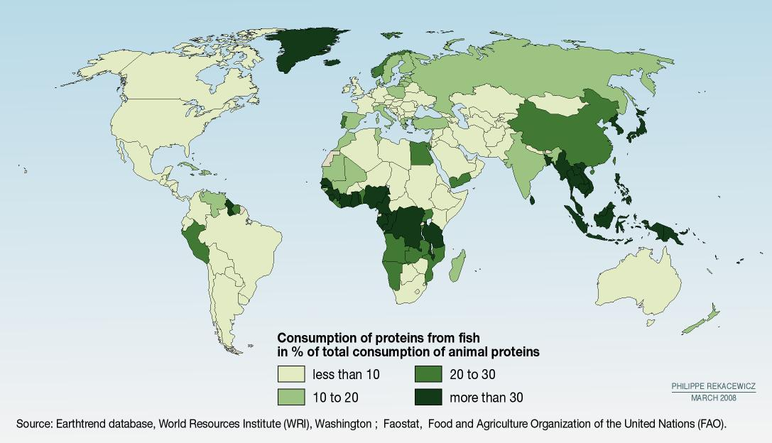
Cloropleth Maps
Title of Map? Fish or Meat for Dinner
Short Description
As can be seen from a juxtaposition of meat and fish consumption maps, globally fish consumption does not complement or supplement meat consumption.
Many of the countries
in the top “carnivorous”
category (U.S., Spain,
Australia, & New Zealand) are also in the top fish-eating category, consuming more than 20 pounds of fish per capita annually. Canada and most countries in Western and Northern Europe too consume a lot of meat, as well as fish. However, meat-loving Argentineans and Brazilians eat relatively little fish, less than 10 pounds a year.
Source:
http://www.geocurrents.info/cultural-geography/culinary-geography/global-geography-of-meat-and-fish-consumption

Slide 7
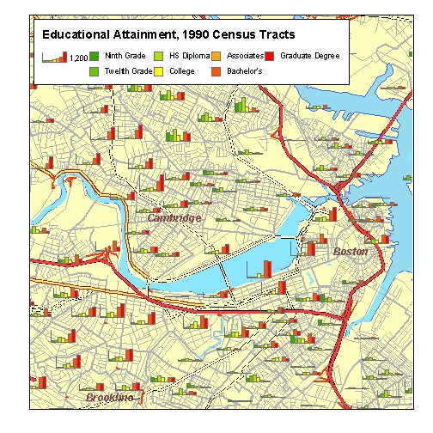
Proportional Symbol Maps
Title of Map:
Educational Attainment in Urban Boston
Short Description
Each census tract has a row of bar charts, the height of each bar determined by the number of people having attained a certain level of education. Since the boundaries of the tracts are shown, the user's eye can weigh the amount of color in the bar chart, and compare it with the size of the area around it.
This technique reveals interesting patterns within and among census tracts. Note that the bar charts in tracts along the Charles River slope up and the north, there are tracts whose charts slope down, indicating a relative majority of people with lower levels of education.
Source: http://www.gsd.harvard.edu/gis/manual/normalize/

Slide 8
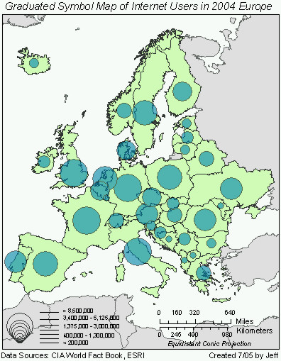
Proportional Symbol Maps
Title of Map:
Internet Users in Europe, 2004
Short Description
Caution should be used when looking at proportional circles. For example the Northern countries of Europe tend to have a higher percentage of their populations online however the viewer might also assume that they have large(r) populations when in fact it is simply a larger % of their population that are internet users.
Source:
http://www.geog.ucsb.edu/~jeff/gis/proportional_symbols.html

Slide 9
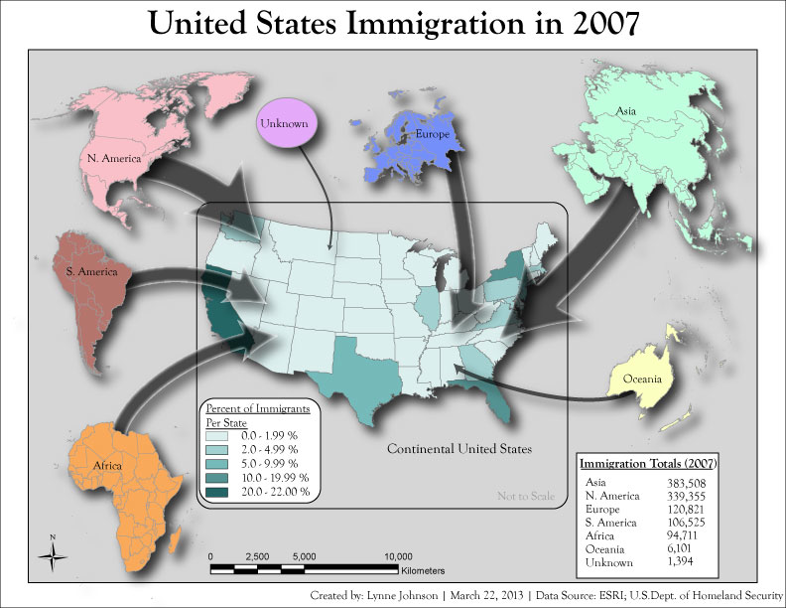
Flow Line Maps
Title of Map:
US Immigration in 2007
Short Description: In this map, the flow line width is proportional to the total immigration from that continent in 2007. This was calculated by using an equation and data collected by the U.S. Dept. of Homeland Security. Caution should be used when viewing the flow lines because they do not indicate where migrants actually ended up living
Source: http://lej11.blogspot.com/2013/03/cartographic-skills-lab-10-flow-maps.html

Slide 10
Online Thematic Map Examples
Title of Map?
Short Description
Source:

